Slide 1
Supertracker and my plate log-in info

Slide 2
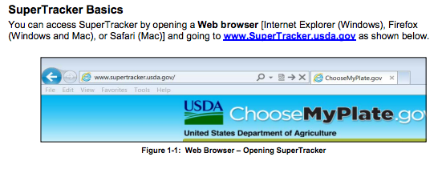
go to supertracker Web page

Slide 3

the supertracker home page

Slide 4
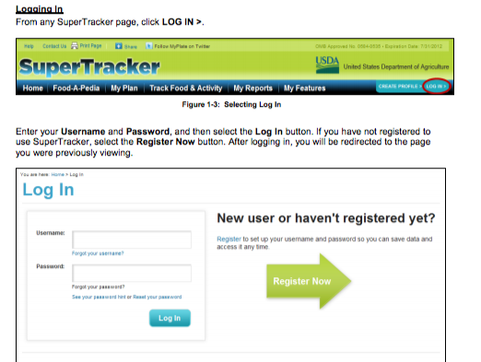
Click on “log in”

Slide 5
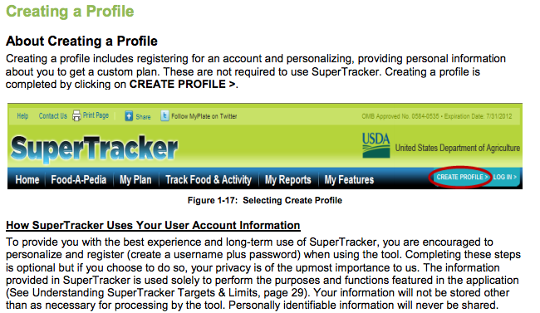
Creating a profile

Slide 6
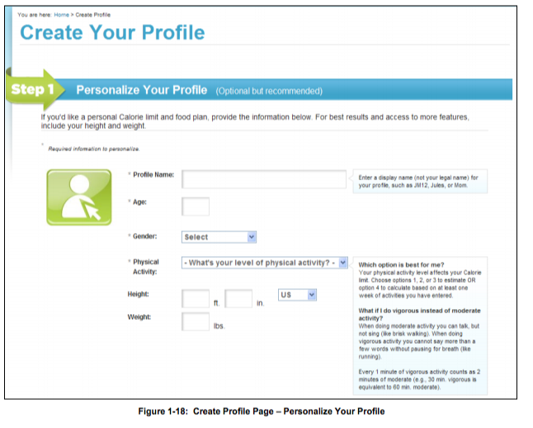
Create your profile

Slide 7
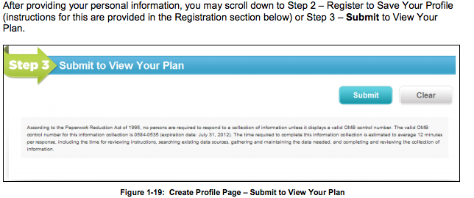
submit your info

Slide 8
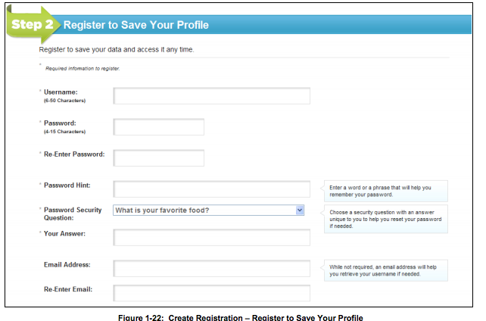
Register to save your profile tip: write this down so you don’t forget

Slide 9
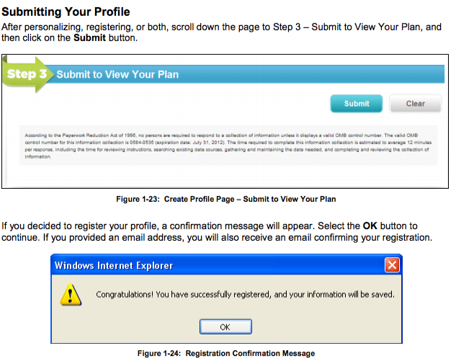
Submit your profile

Slide 10
Success!

Slide 11
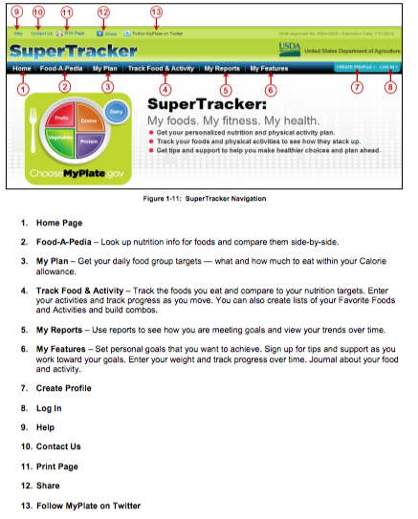
Navigation info

