Slide 1
HSCII Motor Skills Study Guide
Created
By
Dr. Butler for HTH

Slide 2
Review of Tumbling

Slide 3

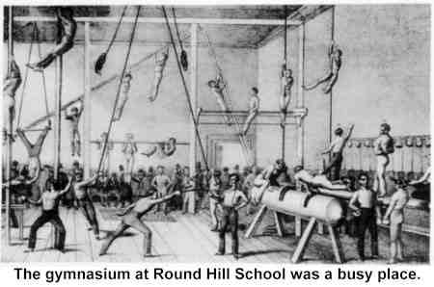
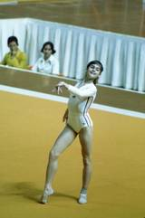
History of Gymnastics
1700s – Gymnastics begins in Germany
1800s – Leotard invented
1896 – First gymnastics in Olympics (men)
1928 – First women gymnastics in Olympics
1976 – First perfect score (Nadia Comaneci from Romania scores 10.0 floor routine)

Slide 4
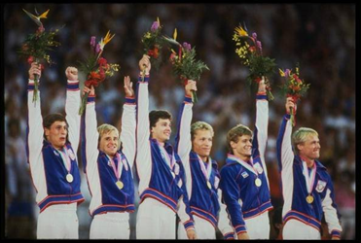
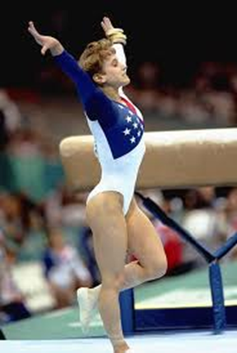
History of Gymnastics Continued
1984 – USA men’s team wins gold in Olympics
1996 – USA Kerri Strug sticks landing on vault with one foot (injured ankle previously)

Slide 5
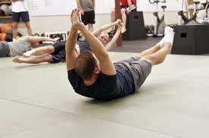
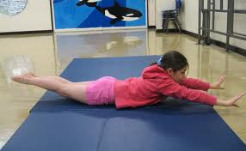
Log Roll
Lay on back with arms extended over head.
Turn head and shoulders to the left or right.
Keep body straight.
Roll around body.

Slide 6
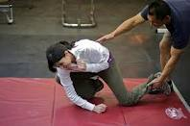
Front Shoulder Roll
Drop one shoulder.
Fall forward placing one arm diagonally across body.
Tilt head forward and to the side.
Tuck chin to chest.
Roll over extended arm, shoulder, and back.

Slide 7
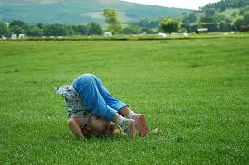
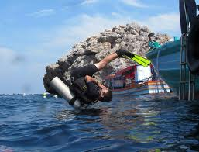
Forward Roll
Assume a squat position.
Tuck chin to your chest.
Push against the ground with your feet.
Lift your hips.
Roll over your rounded back.
Tuck your legs.
Push off with your hands.
Roll forward to a squat position.

Slide 8
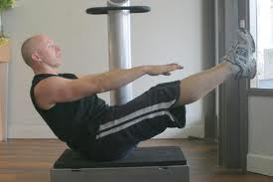
V Sit
Sit on the floor with your knees bent and arms extended.
Extend your knees to assume a "V" shape.
Support your body weight on your seat.

Slide 9
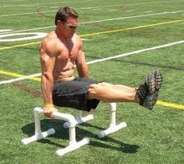
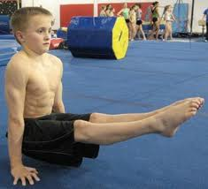
Front Seat Support
Sit on the floor with legs straight and hands flat on the floor between hips and knees.
Point your fingers toward your feet.
Push down against the floor so that your hips come up off the floor.
Lift your heels and support your weight on your hands.

Slide 10
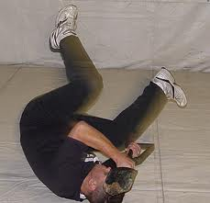
Back Shoulder Roll
From a squat position, roll backward over one shoulder.
Keep knees close to your chest.
Continue moving legs over your body until toes touch the floor.
Turn your head and look toward your knees.
Bring your arms off the floor to complete the roll.

Slide 11
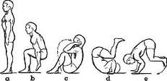
Backward Roll
Assume a squat position with your back toward the mat.
Roll over rounded back.
Keep your knees close to your chest.
Reach over your shoulders with your hands in a palms up position.
Push your hands against the mat to take the weight off your neck.
Bring your body to a squat position.

Slide 12
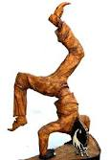
Switcheroo
Perform a front lunge with your arms over your head.
Bend forward at your hips.
Place your hands on the mat.
Kick your back leg up followed by your front leg.
Scissor your legs in the air.
Land with your rear leg in the front.
Land with your front leg in the rear.

Slide 13
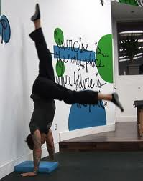
Teeter Totter
Perform a front lunge with arms overhead.
Bend forward at your hips.
Place your hands on the mat.
Kick up your back leg up followed by your front leg.
Hold your feet together for a moment in the handstand position.
Scissor your legs in the air.
Land with your rear leg in the front.
Land with your front leg in the rear.

Slide 14
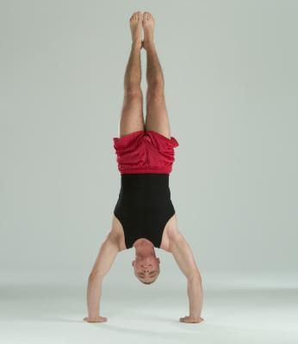
Handstand: Balance Inversion
Start with legs apart and hands over head.
Bend forward at your hips.
Place both hands on the mat.
Kick legs up.
Hold legs together in a straight line.

Slide 15
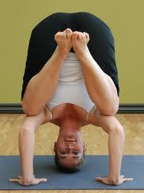
Tripod
Squat down.
Place your hands and head on the mat in a triangular position.
Place your knees on your elbows.
Maintain a balanced position.

Slide 16
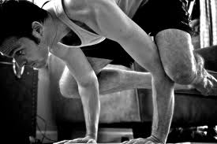
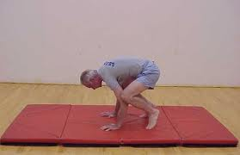
Three Point Tip Up
Squat down.
Place your hands flat on the mat.
Point your fingertips forward.
Position your elbows inside your legs.
Press your elbows against the inner part of your lower thighs.
Lean forward.
Transfer your weight to your bent elbows and hands.
Lower your forehead to the mat.

Slide 17
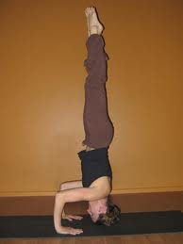
Headstand – Balance Inversion
Squat down.
Place your hands and head on the mat in a triangular position.
Move both feet slowly upward over the your head.
Position your feet together with your legs straight and your toes pointed.
Maintain a balanced position.

Slide 18
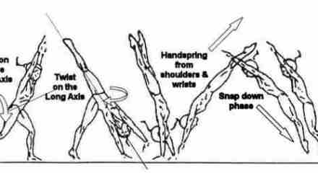
Round Off- Hand-Hand-Both Feet:
Moving Inversion
Start with slight run.
Push off with right foot then left foot.
Place hands close together.
Keep arms straight and your head up.
Push off with both hands.
Bring your feet together.
Make a quarter turn.
Bend at your waist to land on both feet.

Slide 19
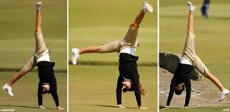
Cartwheel –Hand-Hand-Foot-Foot:
Moving Inversion
Place your hands over your head.
Bend your body to the left.
Place your left hand on the mat.
Place your right hand on the mat.
Place right foot on mat.
Place left foot on mat.
Keep your elbows and legs straight and your head up.
Finish in a standing position.

Slide 20
Resources for Tumbling
Livestrong Basic Tumbling
History of Gymnastics
Video: The First Perfect 10 in Gymnastics (Nadia)
Kerri Strug Vault with Broken Ankle

Slide 21
Review of Self Defense

Slide 22
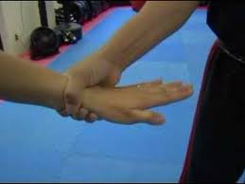
With a “grab” the correct order for escape is:
Step to the side of your attacker.
Turn arm in a half circle.
Use both hands to chop down to break the grip.
Response
Escape
Video: Grab Escape

Slide 23
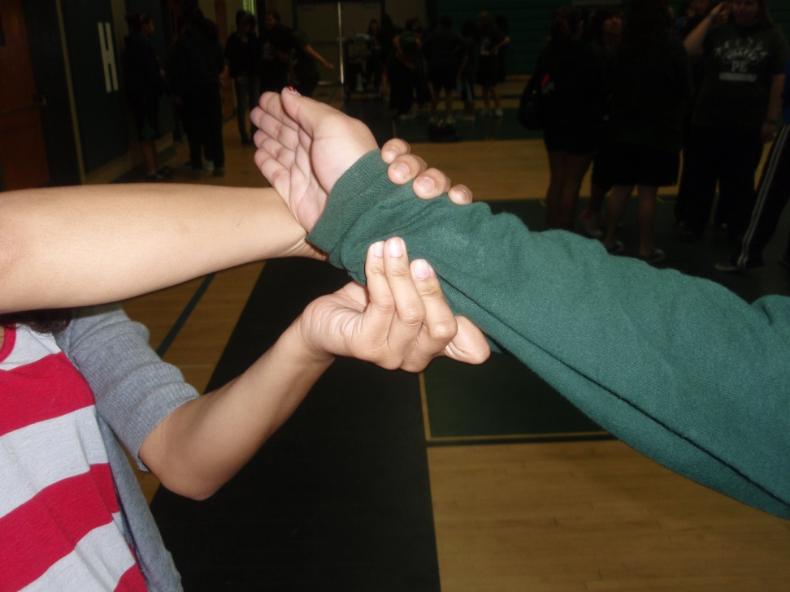
Break the Grip Using Leverage
Side step after grab.
Beginning of half turn.
Completion of half turn.
“Softening Up” attacker.

Slide 24
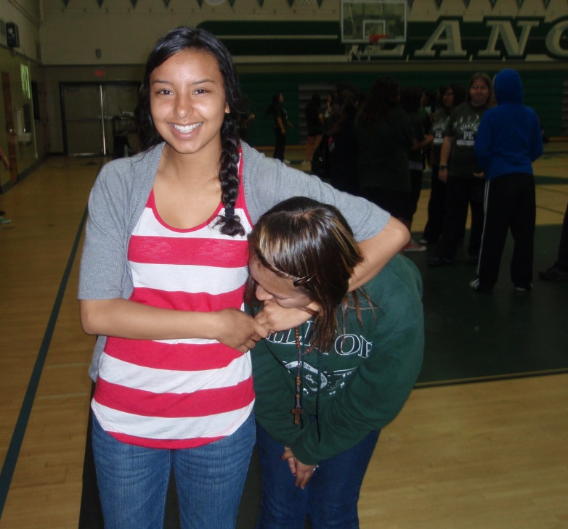
Head Lock
Escape:
Turn chin into the attacker’s arm pit.
Reach arm around to attacker’s face.
Reach hand closest to attacker around and grab his/her face.
Grab attacker’s hand.
“Open Up”--Stand up and look away

Slide 25
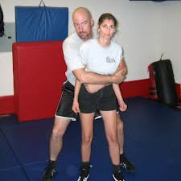
Over Arm Hugs Front and Back:
Drop your weight
Get in an athletic stance.

Slide 26
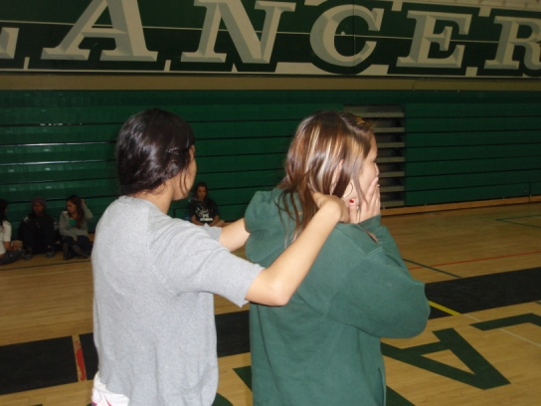
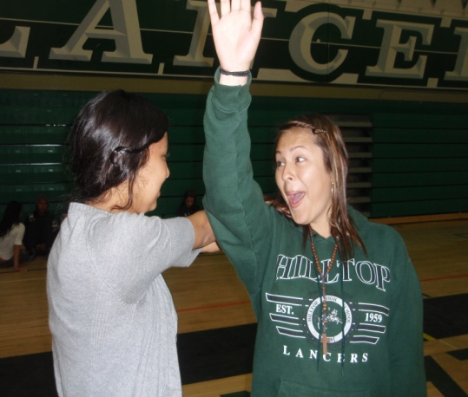
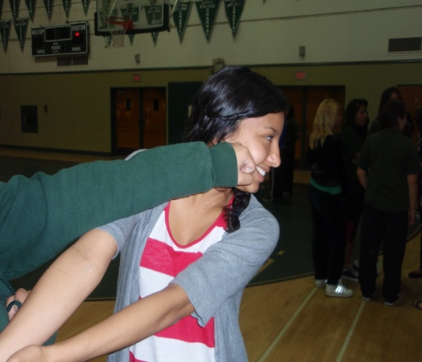
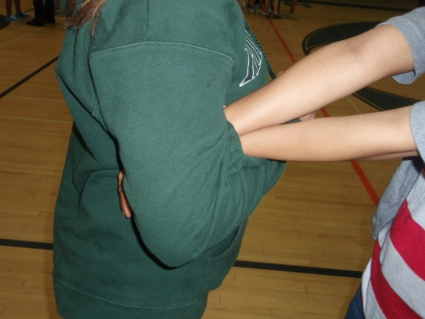
Choke from Behind Escape:
Tuck chin
Turn to the side and swing arm over his/her arms
Pin his/her arms
Going away present

Slide 27
Review of Team Activities

Slide 28
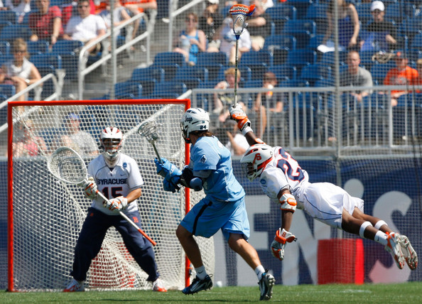
SKILLS NEEDED FOR EFFECTIVE OFFENSE AND DEFENSE
Reaction Time
Agility
Speed

Slide 29
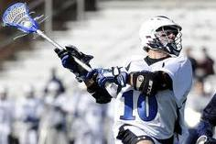
TO PASS FOR DISTANCE:
Biomechanical Principles:
Leverage
Opposition
Rotary Motion

Slide 30
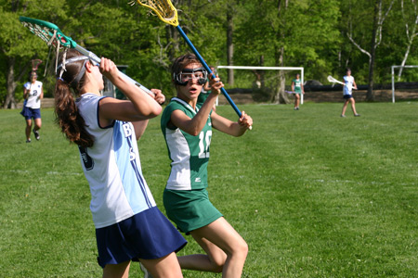
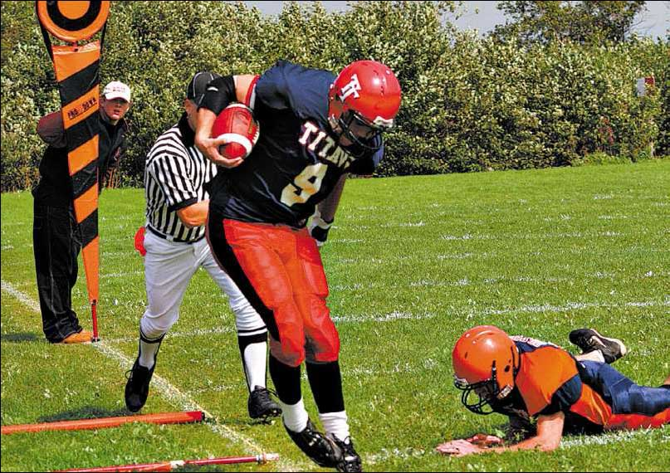
EXAMPLE:
PROPRIOCEPTION
USE IN SPORTS
The player feels that the ball is about to fall out of the net and makes an adjustment
The player feels they are about to step out of bounds before catching football.

Slide 31
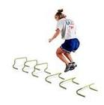
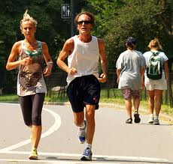
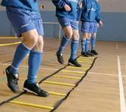
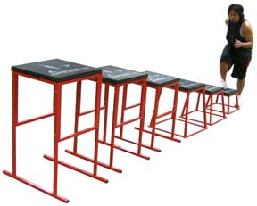
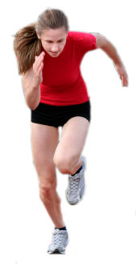
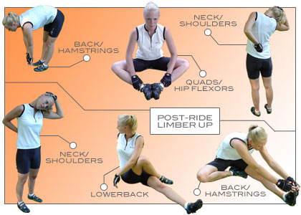
Training Practices for Active Sports
Agility drills
Plyometrics
Endurance cardio
Sprints
Resistance training for speed
Stretching.

Slide 32
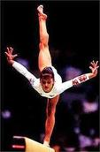

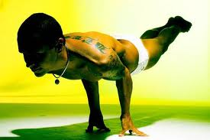
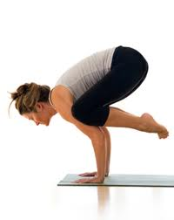
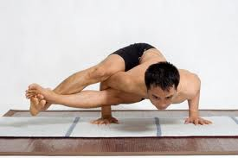
Balance
An even distribution of weight enabling someone or something to remain upright and steady.

Slide 33
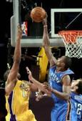
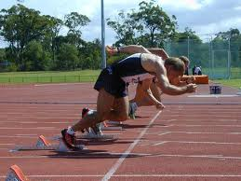
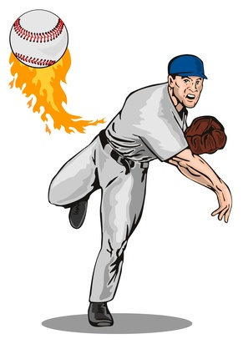
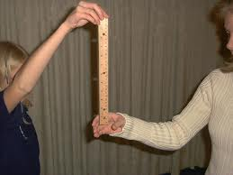
Reaction Time
The time that elapses between a stimulus and the response to it.

Slide 34
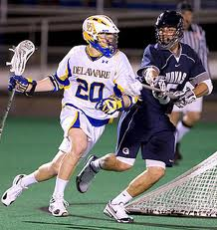



Agility
The ability to change directions quickly.

Slide 35







Coordination
The organization of the different elements of a complex body or activity so as to enable them to work together effectively.

Slide 36








Explosive Power
Power by definition is the rate at which we can apply maximal force against an external load or surface.

Slide 37







Speed
Time an object or person travels across a distance.

Slide 38




Force
A push or a pull applied to an object or person, measured in pounds or newtons.

Slide 39






Inertia
The tendency of a body at rest to remain at rest or of a body in straight line motion to stay in motion in a straight line unless acted on by an outside force.

Slide 40






Bouyancy
  1. The ability or tendency to float in water or other fluid.
  2. The power of a liquid to keep something afloat

Slide 41






Leverage
1. a. The action of a lever. b. The mechanical advantage of a lever. 2. Positional advantage; power to act effectively

Slide 42






Rotary Motion
The act of rotating as if on an axis; "the rotation of the dancer kept time with the music"

Slide 43




Opposition
The use of body parts on opposite sides of body to increase force and power.

Slide 44







Proprioception
The ability to sense the position and location and orientation and movement of the body and its parts.

Slide 45




Sports Specific Training:
Plyometrics
A type of training designed to produce fast, powerful movements, and improving performance in sports.
Jump higher.
Run faster.

Slide 46





Sports Specific Training:
Endurance
To be able to remain vigorous for a long time.
Train with low weights and high reps.

Slide 47



Sports Specific Training:
Combination Strength and Endurance
Medium weight and reps.
Combination of plyos, strength, endurance and sprints.

Slide 48




Defensive Strategy:
Man to Man
(Person to Person)
When your team does NOT have the ball and wants to keep the other team from scoring.
Each player on the team guards a player from other team.

Slide 49




Defensive Strategy:
Zone
Players guard an area.
Any opposing players that come in their area, they play defense against that player.
Allows for easy double/triple teaming

Slide 50



Defensive Strategy in Self Defense
Look around
Yell loudly for help.
Find an opening for escape.
Strike attacker in vulnerable spots.
Run away.

Slide 51





Offensive Strategy:
Quarterback Plays
Plays called by the quarterback.
Players run to open space to receive football pass.

Slide 52




Defensive
Strategy:
Interception
When a player on the opposite team disrupts the play of team with the ball.

Slide 53



Offensive Strategy:
Move to Open Space
Team mate breaks open away from defense to be available to receive a pass.

Slide 54



Offensive Strategy:
Give and Go
Pass to a team mate.
Go to open space.
Receive pass and continue with play.

Slide 55




Offensive Strategy:
Inbound Play
Throw the ball in play.
Teammate(s) move to open space to receive pass.

