Slide 1
Client Bios
Select one client for your Project

Slide 2
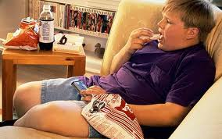
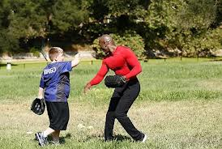
Bingo
Bingo – Is an 8 year old boy who is starting to get overweight. He loves baseball and video games. His parents are worried that if they don’t get a handle on his weight now that Bingo will continue to gain weight and his quality of life will decrease.
Loves video games (5 hours a day).
Loves the Padres baseball team.
Bingo wants to lose 50 pounds, gain muscular strength and speed so he can play baseball on an after school team.

Slide 3
Bingo Info
Fitnessgram Scores
Typical Diet
Height: 4’8”
Weight: 150 lbs
One Mile Run: 15:00
Push Ups: 0
Curl Ups: 0
Flexibility: Shoulder Stretch
Consumes 3,500 calories a day.
Breakfast: Chocolate Muffin and Chocolate Milk
Snack: Takis and Soda
Lunch: Carne Asada Burrito and Soda
Snack: Hot Cheetos
Dinner: Pizza and Soda
Snack: Macaroni and cheese from the box
Dessert: Large serving of cake or pie, whatever mom baked for the night

Slide 4
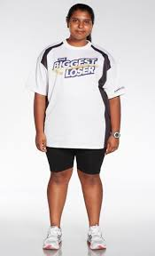
Sunny
Sunny – An obese 15 year old female who has always struggled with her weight. She is at the age where she wants to go to dances and maybe have a boyfriend but thinks her weight is going to hold her back on being a teen with an active social life.
Loves vegetables and thinks she would like to try Zumba but is too embarrassed to go to a class.
Sunny wants to lose 40 pounds, tone up to look good in her clothes for prom, and get in shape so she can pass the state Fitnessgram test.

Slide 5
Sunny Info
Fitnessgram Scores
Typical Diet
Height: 5’5”
Weight: 225 lbs
One Mile Run: 17:00
Push Ups: 0
Curl Ups: 5
Flexibility: Shoulder Stretch
Consumes 4,000 calories a day.
Breakfast: Large fruit smoothie and waffles
Snack: Cinnamon roll
Lunch: Tacos and Soda
Snack: Large Mocha Frapp
Dinner: Cheeseburger and Fries
Dessert: Girl scout cookies

Slide 6
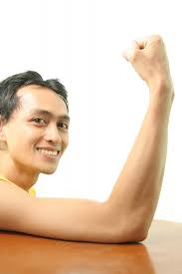
Carlos
Carlos – An athletic thin 16 year old male who has never had a weight problem – just the opposite! Carlos loves to play sports and eats a lot of calories, but just can’t put on any weight. He feels he is too skinny for the sports he wants to play and he wants to put on some muscle “for the ladies”.
Loves basketball, football and any sport where you are active.
Carlos wants to try out for Navy Seals so he wants to prepare for this fitness test. He also wants to put on muscle so he can show off his “guns” this summer in a tank top for the ladies.

Slide 7
Carlos Info
Fitnessgram Scores
Typical Diet
Height: 6’2”
Weight: 150 lbs
One Mile Run: 7:00
Push Ups: 20
Curl Ups: 50
Flexibility: Fail
Consumes 4,000 calories a day.
Breakfast: French Toast
Snack: California Rolls and Soda
Lunch: Burger, fries, soda
Snack: Takis
Dinner: Carne Asada burrito, nachos and a coke.
Dessert: Hah! No dessert - out for cheeseburgers with his buddies.

Slide 8
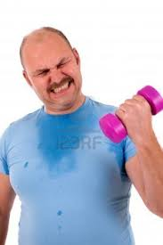
Dan
Dan – An overweight 40 year old male. Dan works long hours to provide for his family and feels he never has time to exercise or to spend quality with his family. He is worried because his children and are chubby and his wife is overweight too. Dan wants to be the change agent for his whole family.
Loves to watch sports on TV, especially football and basketball.
Dan wants to learn how to make smart nutrition choices, wants to lose 40 pounds and be a role model for his kids and wife. Would love to find activities he can do with his family outside that are healthy.

Slide 9
Dan Info
Fitnessgram Scores
Typical Diet
Height: 5;10”
Weight: 250 lbs
One Mile Run: 16:00
Push Ups: 10
Curl Ups: 30
Flexibility: Fail
Consumes 4,500 calories a day.
Breakfast: Coffee and Muffins
Snack: 2 donuts
Lunch: Double Cheese Burger, Onion Rings, Soda
Snack: Two Candy Bars
Dinner: Salad, Fried Chicken, Biscuit, Corn, Soda
Dessert: Large bowl of ice cream and cookies,

Slide 10
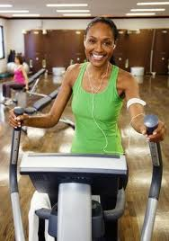
Edna
Edna – A thin 38 year old female. Edna is a single mom with a teenage daughter. Edna is thin, but notices she has terrible cardio fitness as evidenced by her getting winded walking up the stairs at work. Her mother recently had a heart attack and Edna realizes she hasn’t been eating healthy or exercising and worries about her own health. Also, she feels she is not being a good role model for her daughter so she is doubly motivated to get in shape.
Lifelong goal is to hike Mt. Whitney (although she does not hike now)
Edna wants to find a fitness activity she can do with her daughter. She is open to tennis, hiking, or anything they can do outside that will let them spend time together and get in shape. Edna doesn’t need to lose any weight, but she needs to improve her cardio and tone up.

Slide 11
Edna Info
Fitnessgram Scores
Typical Diet
Height: 5’4”
Weight: 120 lbs
One Mile Run: 15:00
Push Ups: 0
Curl Ups: 0
Flexibility: Pass Shoulder Stretch
Consumes 1,800 calories a day.
Breakfast: 1 Boiled egg and juice
Snack: Donut
Lunch: Salad, chicken breast, crackers
Snack: Carrots and hot tea
Dinner: Salmon, green beans, baked potato.
Dessert: Fruit popsicle.

Slide 12
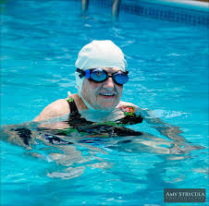
mildred
Mildred – A 75 year old woman who wants to build muscular strength and improve her balance. She recently fell and although she didn’t hurt herself too badly, it was the wake up call she needed. Without improving her balance and strength to catch herself if she falls, again she is afraid she will break a hip or worse.
Loves to play doubles tennis with her friends, but she admits there is more talking than playing.
Mildred wants to improve her muscular strength for her arms, legs, and core. She wants to learn exercises to improve her balance. She wants to learn how to improve her cardio fitness without hurting her arthritis joints in her knees and ankles. She would like to lose 10 pounds.

Slide 13
Mildred Info
Fitnessgram Scores
Typical Diet
Height: 5’2”
Weight: 140 lbs
One Mile Walk: 20:00, Heart Rate 165
Push Ups: 0
Curl Ups: 3
Flexibility: Fail flexibility
Consumes 2,00 calories a day.
Breakfast: Raisin bran cereal, toast, orange juice
Snack: bagel
Lunch: Whole wheat bread turkey sandwich, chips, soda
Snack: Fruit cup
Dinner: Baked chicken, roasted vegetables, salad.
Desert: Pudding

