Slide 1
Supertracker Reports

Slide 2
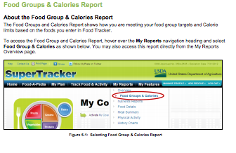
Food Groups & Calories Report

Slide 3
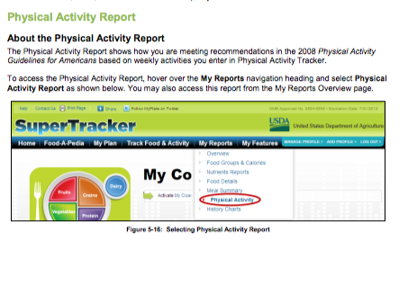
Physical Activity Reports

Slide 4
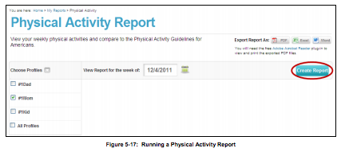
Create a Report

